Slide 1
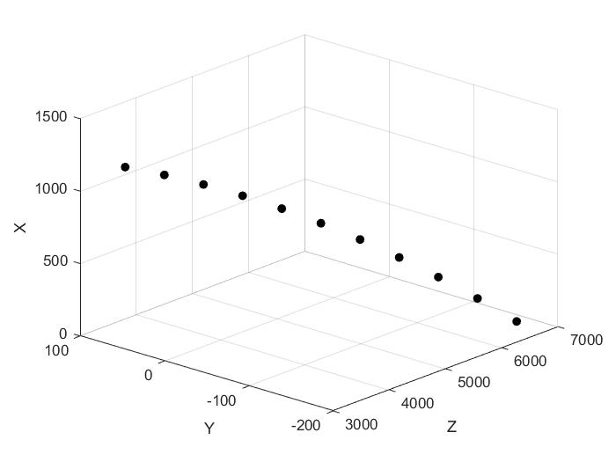
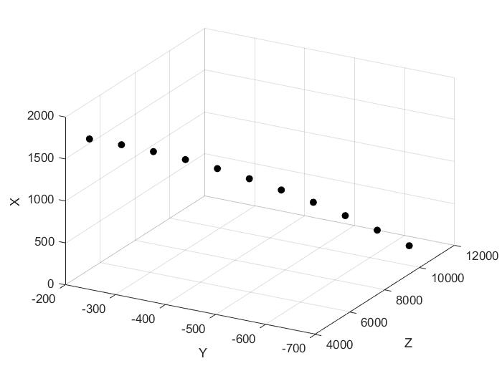
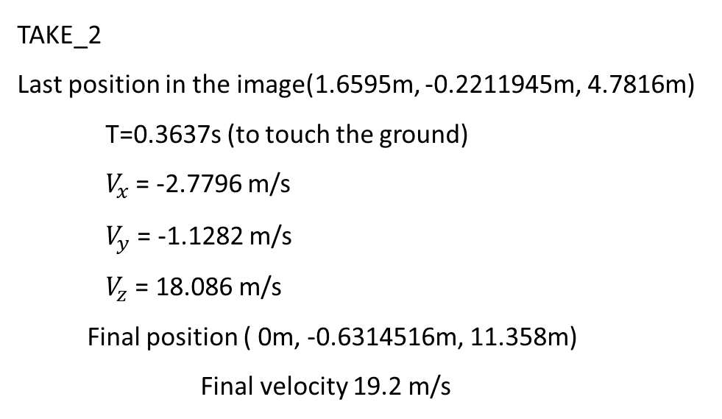
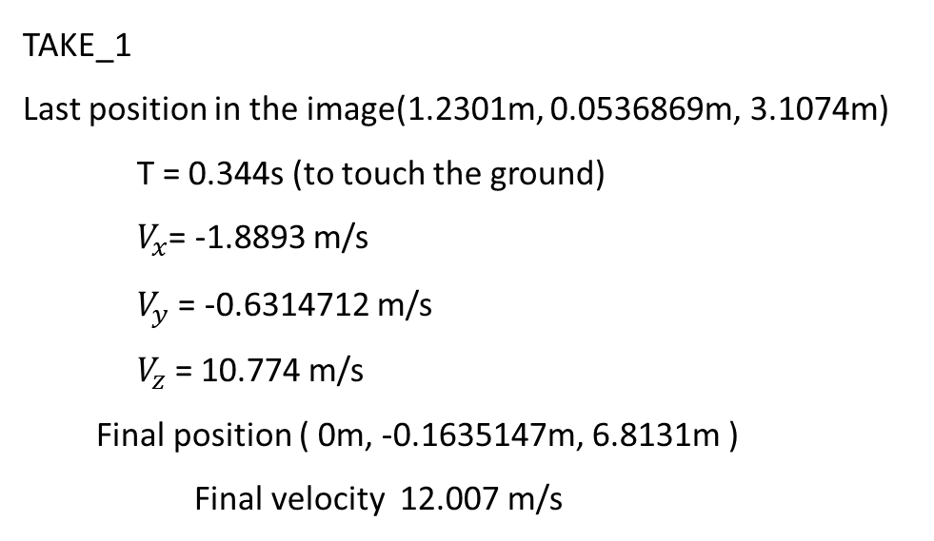
TAKE_1
Last position in the image(1.2301m, 0.0536869m, 3.1074m)
T = 0.344s (to touch the ground)
$V_{x}$= -1.8893 m/s
$V_{y}$= -0.6314712 m/s
$V_{z}$= 10.774 m/s
Final position ( 0m, -0.1635147m, 6.8131m )
Final velocity 12.007 m/s
TAKE_2
Last position in the image(1.6595m, -0.2211945m, 4.7816m)
T=0.3637s (to touch the ground)
$V_{x}$= -2.7796 m/s
$V_{y}$= -1.1282 m/s
$V_{z}$= 18.086 m/s
Final position ( 0m, -0.6314516m, 11.358m)
Final velocity 19.2 m/s
mm
mm

